Slide 1
Honest Mormon Nuttiness
What happens when you finish the quote, apply the logic elsewhere, or use the full context

Slide 2
What is Nutty History?
"Well, we have nothing to hide. Our history is an open book. They may find what they are looking for, but the fact is the history of the church is clear and open and leads to faith and strength and virtues." -Gordon B. Hinkley
Anti-Mormon- Making things up or skewing events to hurt the Church
Pro-Mormon- Making things up or skewing events to help the church
History- What actually happened
Nutty History- What actually happened, but not fully represented (It was too nutty to share

Slide 3
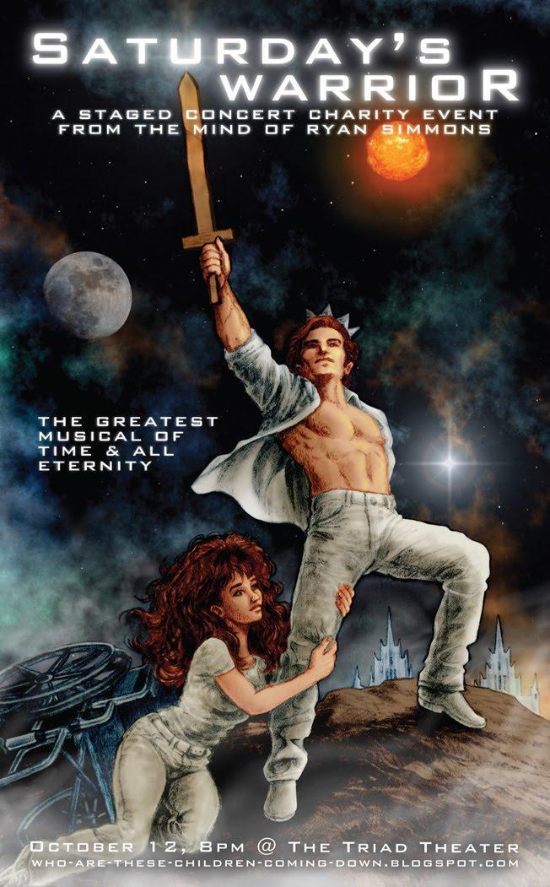
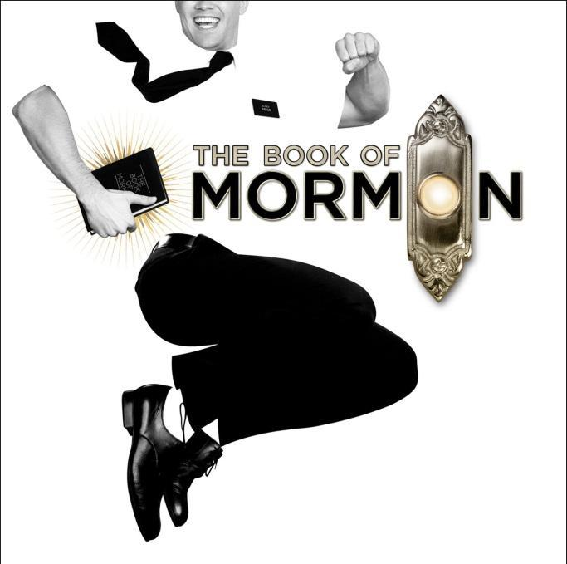
Antimormon vs. Uncomfortable Mormon
Saturday’s Warrior- http://www.exploringmormonism.com/?p=602
Inaccurate doctrine (Life begins at birth, After death we return to the pre existence, Pre-selected Love interests, etc.)
Feels good, appeals to mormon sensibilities
Widespread, shown at firesides, FHE, Youth activities for years
Book of Mormon Musical
Accurate doctrine (Standing up to warlords, divine revelation, given the words to speak the very minute they need it, Gathering to Zion)
Coarse, uncomfortable (Brigham Young, “I shit on your congress”)
Points out the silliness in literal belief

Slide 4
Dousing Rods
1835 copy of Book of Commandments says that Oliver Cowdery had “power of the Rod”- changed to “rod of Aaron”
http://www.mormonthink.com/rodofaaron.htm
FAIR/FARMS response- The reference was later changed to the "gift of Aaron," but we can only speculate as to the exact reason why.
Father Smith consecrated dousing rods in the kirtland temple before a treasure hunt in 1836 (Quinn, D. Michael, The Mormon Hierarchy: Origins of Power, Appendix 7: Selected Chronology of the Church of Jesus Christ of Latter-day Saints)
Coffins turned into canes for the 12
Oliver Cowdery’s rod- turned into Brigham’s Cane
http://www.reddit.com/r/exmormon/comments/vdzwd/may_have_to_pay_myself_50_second_source_for/
http://www.reddit.com/r/exmormon/comments/vaodz/the_hundredaire_challenge_up_to_350_for_grabs/

Slide 5
Arsenic and Old Men
Samuel Smith (Joseph’s brother) was to succeed him. He cried out that he was poisoned. Hosea Stout (Chief of Navoo Police) was his nursemaid
String of Arsenic poisoning in Nauvoo related to individuals who revealed polygamy (forthcoming)
Brigham Young died with symptoms of Arsenic poisoning
Wilford Woodruff and the Bohemian Club (Illuminati connection)

Slide 6
Finish the quote- Principles
“If there are any principles which have given me strength, and by which I have learned to live more truly a life of usefulness, it seems to me I could wish to impart this joy and strength to others; to tell them what the Gospel has been and is to me, ever since I embraced it and learned to live by its laws. A fresh revelation of the Spirit day by day, an unveiling of mysteries which before were dark, deep, unexplained and incomprehensible; a most implicit faith in a divine power, in infinite truth emanating from God the Father. – Elizabeth Ann Whitney
Rewards offered to her father to marry her to Smith at age 17 (Statutory rape)

Slide 7
Finish the Quote- Trial
"if this court record is authentic it is the most damning evidence in existence against Joseph Smith.” – Hugh Nibley on 1826 trial
http://richkelsey.org/1826_trial_testimonies.htm (including court record scanned in)
FAIR/FARMS reply “He was found not guilty”
Why would it be damning if found if he was not guilty?

Slide 8
1826 Trial- Animal killed
Killed Sheep
Killed black dog John C. Bennett remarked that Joseph told him to kill a sheep and use its entrails for repentence
(FAIR remarks: "Thus even if one accepts these reports as accurate (rather than as malicious slander, satire, or village gossip)“
“ Joseph told them to go to Kirtland and cleanse and purify a certain room in the temple, that they must kill a lamb and offer a sacrifice unto the Lord which should prepare them to ordain Willard Richard a member of the Quorum of the Twelve Apostles.” -Wandle Mace
[Speaking of the temple plan] Under the pulpit in the west end [Aaronic priesthood end] will be a place to offer sacrifices. There will be an altar prepared for that purpose so that when any sacrifices are to be offered, they should be offered there." [Journal of Wilford Woodruff, December 18, 1857
"When we see a temple built right, there will be a place for the priests to enter and put on their robes, and offer up sacrifices, first for themselves, and then for the people." [Heber C. Kimball Journal, January 2, 1846. Cited in BYU Studies, Vol. 16, no. 3 (Sp 1976), p. 384.]

Slide 9
Family Dagger
Michael Quinn found a family dagger in Hyrum’s possession
Drew in ground with dagger (FAIR argues they never claimed the dagger, but others brought swords for this purpose, That Quinn gets the dates wrong, the sigils importance, and uses sources that are too late)
WHY DID THEY HAVE A DAGGER?
Bring you own dagger to the temple (Times and Seasons), to cut the symbols into the garments

Slide 10
Finish the Quote-Plates
Sally Chase in the Ensign is described as a wicked seer who attempted to take the plates
Willard Chase was part of the treasure hunting group
Joseph went to Willard to get the box he kept the plates in, promising him a portion of the revenue from the plates as payment (Willard Chase affidavit)
Joseph obtained his first seerstone via Sally Chase, and his second from that first seerstone (The Refiner’s Fire: The Making of Mormon Cosmology, 1644-1844 p. 151-152)
Samuel Lawrence is only mentioned in trying to steal the plates, but Joseph took him to the hill Commorah in 1825, he was the first person to see the Nephite interpreters with the plates

Slide 11
Nutty Statistics- Polygamy
Todd Compton (FAIR) says Fanny Alger occurred in 1832. Eliza R. Snow says the wedding occurred in 1836 as per Brian Hale’s (FAIR) book citing Joseph F. Smith’s notes. This leads FAIR to concludes she was a legitimate wife ( Sex 4 years before wedding, no problem)
Joseph Smith married 1 woman every 25 days during Nauvoo (With 6 month break after Sarah Pratt)
Two Fatherless sisters, one who testified he had sex with her in a bed once, but not only sex once
11 were previously married, 5 were married to the 12 (two did not go through with it)
11 were teenagers
FAIR argues that 14 year old Helen Mar Kimball there was no sex involved.
Orson Hyde left in 1841 for his mission. In 1843 She gave birth to a baby. Joseph Smith took her as a plural wife in 1842.
Lorenzo married 14 year old when 56, somehow is left out of the manual timeline

Slide 12
Zebadee Coultrin
First seven presidents of the Seventy
Second counselor in the Kirtland Stake
Ordained a patriarch by John Taylor in 1873
Died Faithful at 83
Called on mission in D&C 52:29
Mentioned in Ensign
”the Savior had appeared during a meeting two or three weeks after the organization of the original School of the Prophets in Kirtland. He passed through the room without speaking, and Joseph Smith identified the holy visitor: ‘That is Jesus, the Son of God, our elder brother.’”
What they didn’t say:
Joseph, stepped between Brothers Cowdery, and Coltrin and taking them by the arm, said, "lets take a walk … then said, "Let us pray." They all three prayed in turn--Joseph, Oliver and Zebedee. Bro. Joseph then said, "now brethren we will see some visions." Joseph lay down on the ground on his back and stretched out his arms and the two brethren lay on them. The heavens gradually opened, and they saw a golden throne, on a circular foundation, something like a light house, and on the throne were two aged personages, having white hair, and clothed in white garments. They were the two most beautiful and perfect specimens of mankind he ever saw. Joseph said, They are our first parents, Adam and Eve. Adam was a large broad shouldered man, and Eve as a woman, was as large in proportion.
An original source of Joseph Smith teaching “Adam is God” if you review all the related quotes

Slide 13
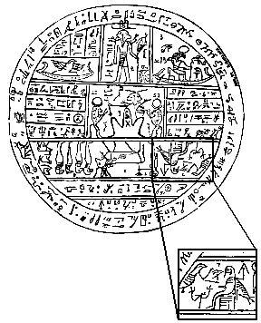
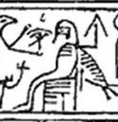
(Min)imum Nuttiness

Slide 14
Future Nuttiness
Crossdressing GA’s
Gay Patriarch’s
Harold B. Lee’s Religion
David Whitmer, second prophet of the restoration, was right
Joseph Smith III and Hinkley’s dirty little secret
John W. Taylor, the faithful Scandal
George Q. Cannon and a quarter Million Dollars
J. Golden Kimball and a man with a dream
Bowie Knives in the temple
Razor blades, throats and temple oaths
King Follec Discorse (rings and things)
Rocky Mountains over a barrel
White horses and civil wars

Slide 15
Mithryn
Exmormon.reddit.com
ExploringMormonism.com
Mormons and Conspiracy (Working title)

